Slide 1

Dynamic Slimmable Network
Changlin Li Guangrun Wang Bing Wang Xiaojun Chang GORSE Lab, Dept. of DSAI, Monash University
Univeristy of Oxford Alibaba Group CVPR, 2021 Oral
Reporter: Tang Qidong, 2021.06/15
Notes:
Dynamic slimmable network 在测试时根据不同的输入，可以预测性地调整网络的滤波器filter数量，实现良好的硬件效率。
DS-Net成功解决了以往动态网络剪枝（dynamic pruning）算法中硬件效率低下和计算浪费的问题，在ImageNet上，对于ResNet和MobileNet，达成了2-4×理论加速和1.62×实际加速，超越了现有的剪枝（pruning），网络搜索（NAS）和动态网络压缩方法，并以最高5.9%的精度优势超越了它的baseline ：Universally Slimmable Network。

Slide 2
Outline
Background
Methods
Experiments

Slide 3
Outline
Background
Methods
Experiments

Slide 4
Background
Anytime neural networks:
single networks that can execute with their sub-networks under different budget constraints, thus can deploy instantly and adaptively in different application scenarios. [Variable depth, width, kernel size]
Dynamic neural networks:
reduce average inference cost by using different sub-nets adaptively for different inputs with diverse difficulty levels. [Dynamic depth, width]
Weight sharing NAS:
aim at designing neural network architectures automatically and efficiently; integrate the whole search space of NAS into a weight sharing supernet and optimize network architecture by pursuing the best-performing sub-networks.
Notes:
一系列的方法被提出，用于改进神经网络的inference efficiency.
Anytime neural networks : 可以在不同的预算约束下执行不同的子网络，从而可以在不同的应用场景中即时地自适应地部署 （例如，根据你的算力决定部署20层还是30层的网络，但是这些层都来自于同样的一个大网络，不需要重训）。 变化的可能是depth, width, kernel size
Dynamic neural networks: 通过对具有不同难度级别的输入自适应地使用不同的子网络来降低平均推理成本 (关键是对于不同输入，使用不同网络)。
Weight sharing NAS: NAS 旨在自动高效地设计神经网络架构； Weight sharing 将 NAS 的整个搜索空间整合到一个权重共享超网络中，并通过追求性能最佳的子网来优化网络架构。
这篇文章是一个结合anytime NN 和 dynamic NN的工作

Slide 5
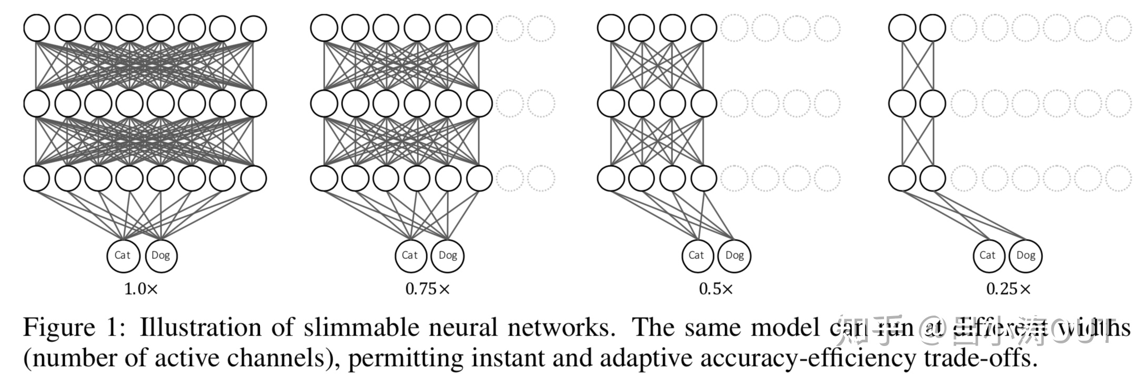
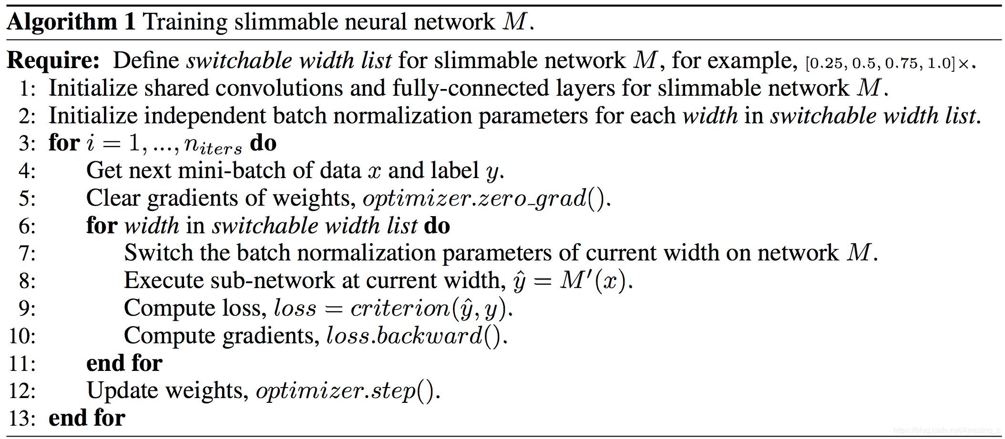
Slimmable Neural Networks
Network with variable width.
Notes:
Slimmable neural networks 是 Anytime neural networks with adjustable width
在训练过程中，每个epoch，同时进行多个不同宽度的网络的forward inference，计算loss并同时求导。
唯一的问题上batch norm，BN层通过对特征进行归一化来保持训练过程中梯度的稳定。在训练时，BN层使用当前Batch的均值和方差进行归一化，并对数据集总体的均值和方差进行估计；在测试时，使用训练中估计的总体均值和方差进行归一化。

Slide 6
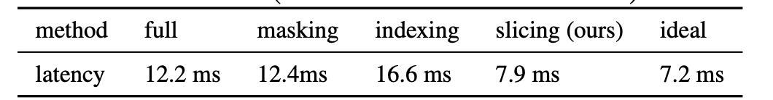
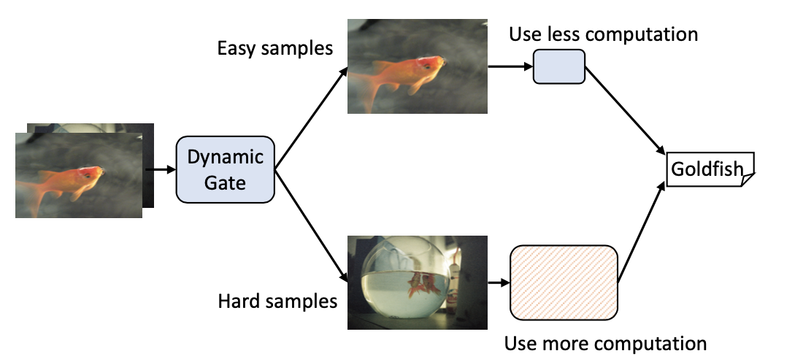
Dynamic Neural Networks
Networks with dynamic width have never achieved actual acceleration in a real-world implementation. As natural extensions of network pruning, dynamic pruning methods predictively prune the convolution filters with regard to different input at runtime. The varying sparse patterns are incompatible with computation on hardware. Actually, many of them are implemented as zero masking or inefficient path indexing, resulting in a massive gap between the theoretical analysis and the practical acceleration.
Notes:
动态网络为每个输入自适应地配置不同的网络结构，而不是像神经网络搜索（NAS）或剪枝那样在整个数据集上优化网络结构，例如，根据每张输入图像的分类难度，将其路由到不同的计算复杂度的网络结构减少了在简单样本上的计算浪费，提高网络效率（见上图）
其中动态剪枝方法，作为剪枝的自然扩展，在运行时根据不同的输入对卷积滤波器进行预测剪枝（如图，对于easy samples, ）。这种变化的稀疏模式（spasepattern）与硬件计算不兼容。实际上，许多算法都是以零掩码（zero-masking）或低效路径索引（indexing）的方式实现的，这使得理论分析与实际加速之间存在很大的差距。如上表所示，zero masking和path indexing都没有实际的加速效果，导致了计算浪费。本文作者提出一种致密（dense）的动态channel切分（dynamic channel slicing）方法，达到了与理论相符的加速效果
具有动态宽度的网络(Dynamic Neural Networks)从未在实际应用中实现过实际加速。 作为网络修剪的自然扩展，动态修剪方法在运行时根据不同的输入预测修剪卷积滤波器。 但是由于不同的稀疏模式与硬件计算不兼容。 实际上，大多数dynamic neural nettworks的实现方式为 zero masking 或低效的path indexing，导致理论分析与实际加速之间存在巨大差距。
这个表格，说明了这种动态调节宽度的方式并无实际效果

Slide 7
Outline
Background
Methods
Experiments

Slide 8
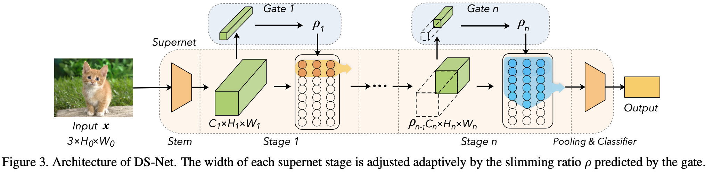
Methods -- DS-Nets
Dynamic slimmable network achieves dynamic routing for different samples by learning a slimmable supernet and a dynamic gating mechanism. The supernet in DS-Net refers to the whole module undertaking the main task. In contrast, the dynamic gates are a series of predictive modules that route the input to use sub-networks with different widths in each stage of the supernet.
Notes:
动态宽度可变网络（DS-Net）通过学习一个宽度可变超网络[a slimmable supernet]和一个动态门控机制[a dynamic gating mechanism]来实现不同样本的动态路由。如上图所示，DS-Net中的超网络（图中下部黄色框）是指承担主要任务的整个模块。相比之下，动态门控（图中上部蓝色框）是一系列预测模块，它们将输入样本路由到超网络的不同宽度的子网络。
之前的动态网络工作将门控和超网络一起训练，而本文为了提高超网络中每个子网络的泛化性，提出了解耦的两阶段训练方法：
在第一阶段，禁用门控并用IEB技术训练超网络；在第二阶段，固定超级网的权重并用SGS技术训练动态门控

Slide 9
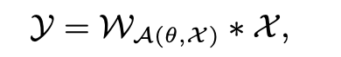
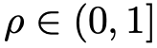
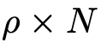
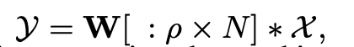
Supernet and Dynamic Channel Slicing
In dynamic networks, the dynamic convolution generally has a form of:
Previous dynamic pruning methods reduce theoretical computation cost by varying the channel sparsity pattern according to the input. However, they fail to achieve real-world acceleration because their hardware-incompatible channel sparsity results in repeatedly indexing and copying selected filters to a new contiguous memory for multiplication. To achieve practical acceleration, filters should remain contiguous and relatively static during dynamic weight selection.
A slimmable ratio indicates that the first piece-wise of the output filters are selected, where [:] is a slice operation.
Notes:
正如前文，普通的dynamic NN的 稀疏模式（spasepattern）与硬件计算不兼容。实际上，许多算法都是以零掩码（zero-masking）或低效路径索引（indexing）的方式实现的，这使得理论分析与实际加速之间存在很大的差距
W表示选择的输入相关的卷积核，*表示矩阵乘法；
为避免产生稀疏channel，作者提出动态可切分（slice-able）卷积，通过预测出的剪枝率 𝜌，动态的切分使用卷积的前 𝜌× n个滤波器（n为总滤波器数）。
通过堆叠动态可切分（slice-able）卷积，如果禁用动态门控，就形成了类似slimmablenetwork的动态超网络；而加上动态门控，就将dynamic NN的思想结合进来啦

Slide 10
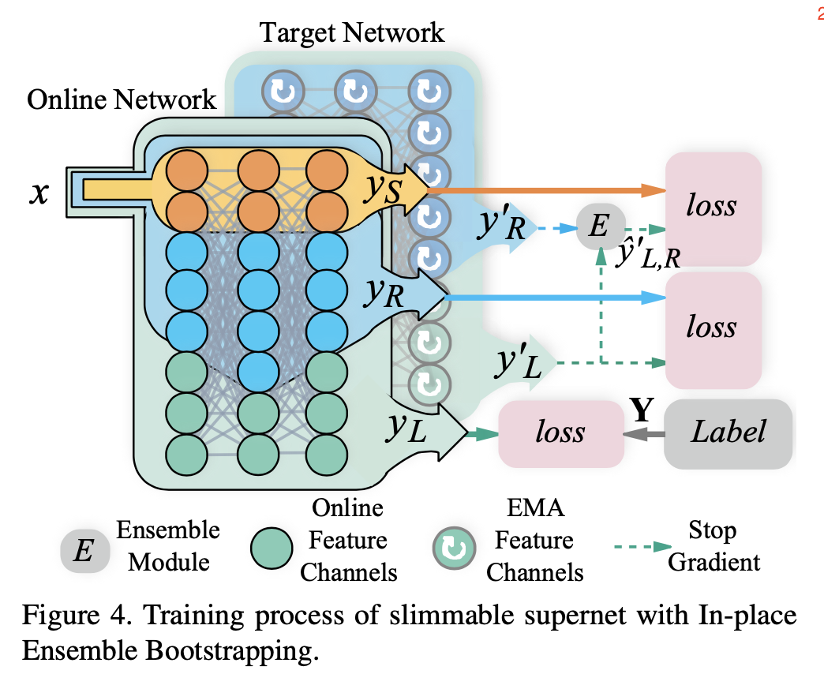
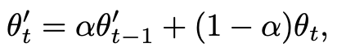
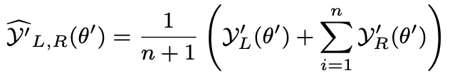
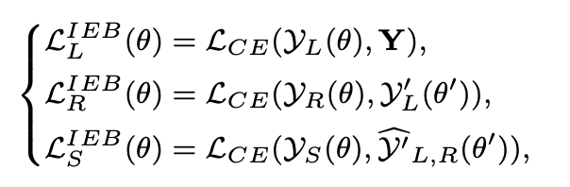
In-place Ensemble Bootstrapping (IEB)
Exponential moving average (EMA) of the model as the target network that generates soft labels. Let θ and θ′ denote the parameters of the online network and the target network:
Use different sub-networks as a teacher ensemble when performing in-place distillation.
Sub-network at the largest width is trained to predict the ground truth label Y;
n sub-networks with random width are trained to predict the soft label generated by the widest sub-network of the target network, YL′ (θ′)
the slimmest sub-network is trained to predict the probability ensemble of all the aforementioned sub-networks in the target network:
Notes:
之前的slimmable network训练使用in-place distillation方法：最宽的子网络学习预测真实标签，同时生成软标签，并通过知识蒸馏的方式来训练其他较窄的子网络。但in-place distillation训练很不稳定，权重在训练早期会大幅突变，并可能导致模型最终训练失败或性能损失。为此，作者提出In-place Ensemble Bootstrapping（IEB）策略来稳定动态超网络的训练并最终提高模型性能.
首先，IEB将网络分成两种，在线网络（online network）和目标网络（target network）。作者使用 exponential moving average (EMA)模型作为目标网络。让 theta 和 theta’ 分别代表在线网络和目标网络的参数。则目标网络更新方式如上。使用超网络的滑动平均（EMA）网络来生成训练子网络的软标签，因为EMA网络提供的目标更加稳定和精准。
其次，使用包括最宽子网络和随机宽度子网络的多个模型的概率集成（probability ensemble）作知识蒸馏，因为多模型集成可以提供更多样、更泛化、更精准的软标签。（见上图）
让最大宽度的在线网络直接学习标签Y，
让随机采样宽度的在线网络去学习最大宽度的目标网络，
让最小宽度的在线网络预测目标网络中所有子网（ensemble）的概率。
记住这里面都是在线学习网络去学习目标网络，目标网络的作用就是产生软标签供在线学习网络学习

Slide 11
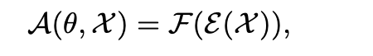
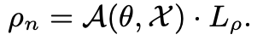
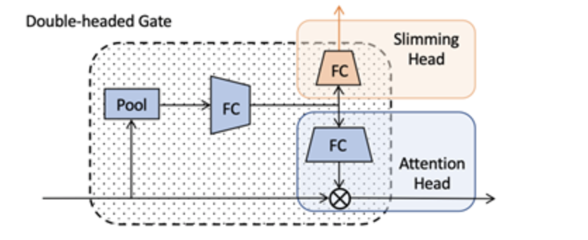
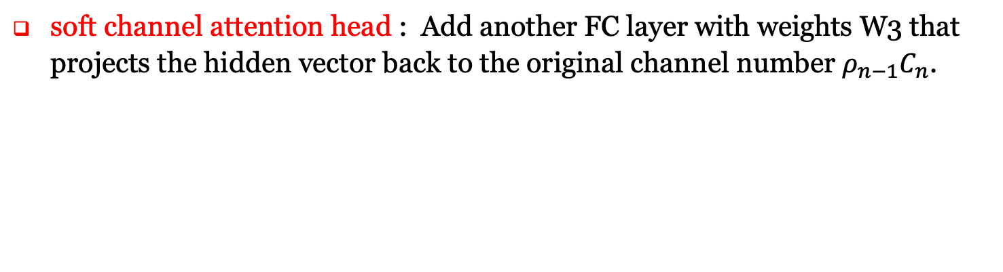
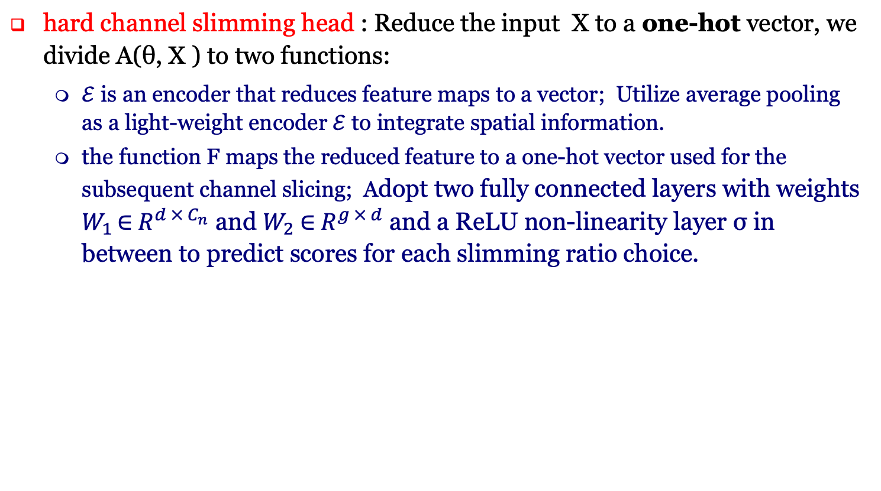
Dynamic Slimmable Gate – Double-headed Design
hard channel slimming head : Reduce the input X to a one-hot vector, we divide A(θ, X ) to two functions:
$ℰ$ is an encoder that reduces feature maps to a vector; Utilize average pooling as a light-weight encoder $ℰ$ to integrate spatial information.
the function F maps the reduced feature to a one-hot vector used for the subsequent channel slicing; Adopt two fully connected layers with weights $W_{1 }\text{∈}{ R}^{d × C_{n}}$ and $W_{2} \text{∈}{ R}^{g × d}$ and a ReLU non-linearity layer σ in between to predict scores for each slimming ratio choice.
soft channel attention head : Add another FC layer with weights W3 that projects the hidden vector back to the original channel number $ρ_{n−1}C_{n}$.
Notes:
首先，作者提出通过当前层输入特征来预测出一个one-hot向量，对应选择剪枝率列表中的一个值。输入特征首先通过全局池化（global pooling）来消除空间维度，再通过两个以ReLU相隔的全连接层，并求argmax，得到one-hot向量。由于这一结构与频道注意力相似，作者将两者除最后一层全连接外的层进行共享，形成包含动态宽度头和频道注意力头的双头动态宽度门控。

Slide 12
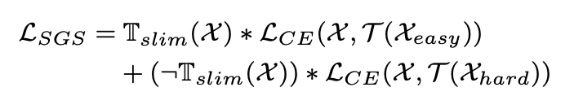
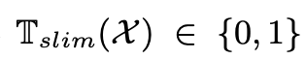
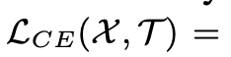
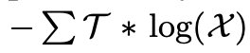
Dynamic Slimmable Gate – Sandwich Gate Sparsification
To optimize the non-differentiable slimming head of dynamic gate, they use gumbel-softmax to differentiable softmax in gradient computation. The gate easily collapses into a static one even if Gumbel noise is added.
Classify input samples into 3 diffeculty levels:
Easy samples: can be correctly classified by the slimmest sub-network;
Hard samples: can not be cor- rectly classified by the widest sub-network;
Dependent samples: other samples in between;
Define the SGS loss that facilitates the gate training:
Where represents whether X is truly predicted by the slimmest sub-nets.
is the Cross-Entropy loss over softmax activated gate scores and
the generated gate target.
Notes:
由于argmax不可导，之前使用argmax作为网络中间层的工作一般使用gumbel-softmax作为替代，来近似求导，以便梯度回传。但是，本文作者发现采用这个方法进行gate训练时，很容易使其gate坍塌成静态
为此，作者提出Sandwich Gate Sparsification训练策略。首先，每个输入样本都按，“是否能被最窄网络正确预测”，分为分类；
对于容易和困难两类。然后，将两类难易样本打上one-hot标签，使用交叉熵直接优化gate。这种训练方式避免了间接和近似的梯度回传，克服了gate收敛困难的问题，并提高了gate的动态多样性

Slide 13
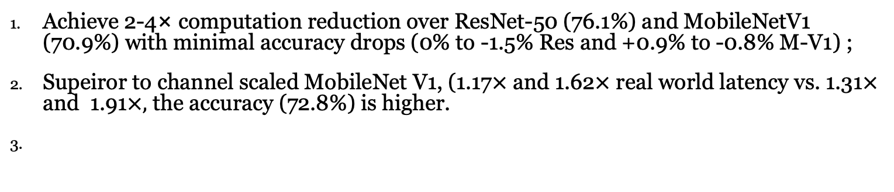
Experiments -- Main Result
Achieve 2-4× computation reduction over ResNet-50 (76.1%) and MobileNetV1 (70.9%) with minimal accuracy drops (0% to -1.5% Res and +0.9% to -0.8% M-V1) ;
Supeiror to channel scaled MobileNet V1, (1.17$×$ and 1.62$×$ real world latency vs. 1.31$×$ and 1.91$×,$ the accuracy (72.8%) is higher.
Notes:
蓝色： lower bounds；最小网络的下限；
绿色： 搜索过程中一些符合 design specification的点
红色： 最优搜索结果
1. 搜索结果总是满足 design specification的
2. The accuracy on CIFAR-10 of the four solutions are 92.85%, 92.62%, 93.23%, and 91.11%, while the accuracy lower bounds from the smallest network is 78.93%
3. 1，3的结果至少有一个维度接近资源限制；2的结果并不如此，说明最好的solution可能并不靠近specs。值得注意的是，2的acc比1，3低。
[并不是越接近资源越好，主要还是因为reward function加入了penalty]

Slide 14
Outline
Background
Methods
Experiments

Slide 15
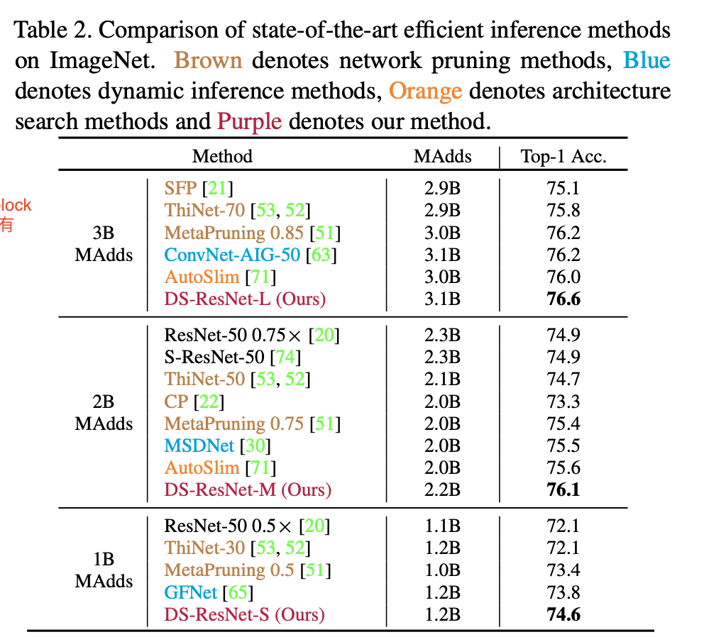
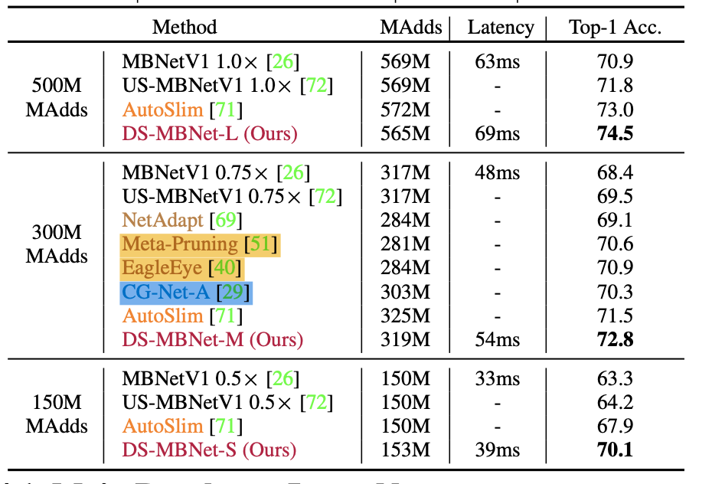
Experiments -- Main Result
Achieve 2-4× computation reduction over ResNet-50 (76.1%) and MobileNetV1 (70.9%) with minimal accuracy drops (0% to -1.5% Res and +0.9% to -0.8% M-V1) ;
outperforms classic and state-of-the-art static pruning methods EagleEye and Meta-Pruning by 1.9% and 2.2%.
Superior to powerful dynamic inference methods with varying depth, width or input resolution.
Consistently outperforms its static counterparts AutoSlim and US-Net by 2.2% and 5.9%.
Notes:
DS-Net超过了现有的模型压缩方法：DS-Net成功加速ResNet-50和MobileNetV1（2-4倍的计算量减少，和1.17倍、1.62倍的实际加速）；优于静态剪枝方法，比EagleEye和Meta-Pruning分别高出1.9%和2.2%；优于其他强大的动态网络，比动态剪枝方法CGNet高出2.5%；也优于静态slimmable网络，比AutoSlim和US-Net分别高出2.2%和5.9%（Figure 1）。

Slide 16
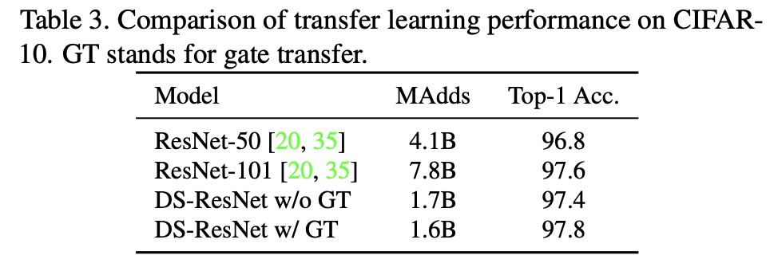
Experiments -- Transferability
Gate transfer boosts the performance of DS-ResNet by 0.4% on CIFAR-10, demonstrating the transferability of dynamic gate.
Both of the transferred DS-ResNet out- performs the original ResNet-50 in a large range (0.6% and 1.0%) with about 2.5 × computation reduction.
DS-ResNet with gate transfer outperforms the larger ResNet-101 with 4.9× fewer computation complexity, proving the superiority of DS-Net in transfer learning.
Notes:
在CIFAR-10上，DS-ResNet可减少2.5倍计算量，并在精度上超过原ResNet50 0.6%和1.0%，甚至以五分之一的计算量，超过ResNet101。（Table 3）

Slide 17
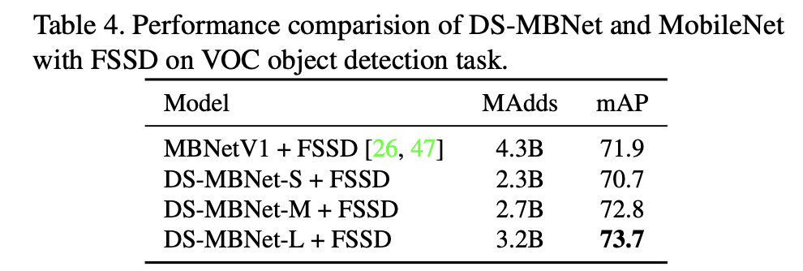
Experiments – Object Detection
Comparing to MobileNetV1, DS-MBNet-M and DS-MBNet-L with FSSD achieves 0.9 and 1.8 mAP improvement with 1.59× and 1.34× computation reduction respectively, which demonstrates that our DS-Net remain its superiority after deployed as the backbone network in object detection task.
Notes:
在VOC目标检测任务，DS-MBNet相比原MobileNet达成了0.9和1.8的mAP提升，同时计算量分别减少1.59倍和1.34倍。（Table 4）

Slide 18
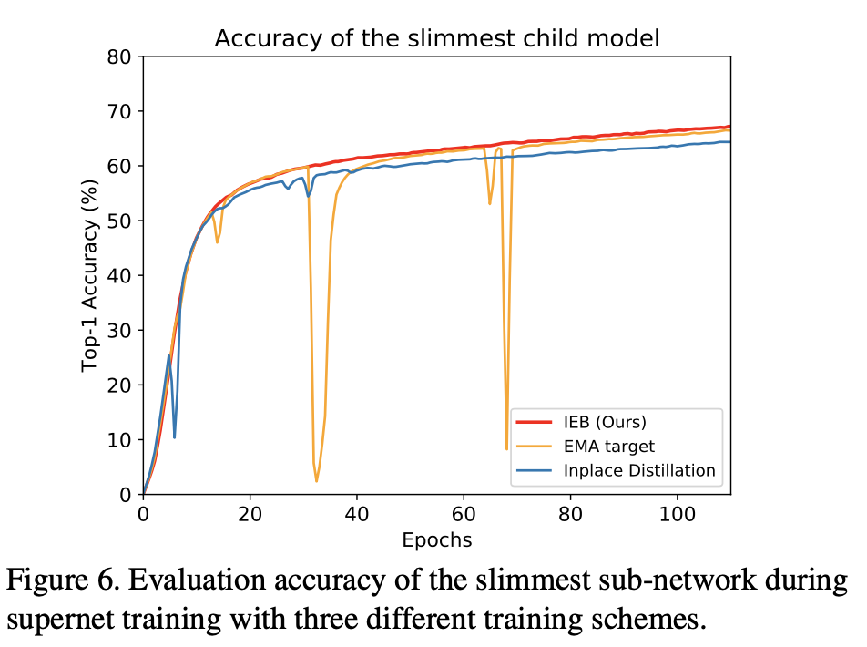
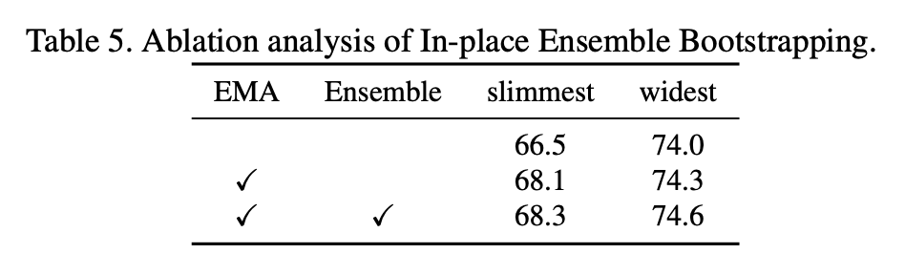
Ablation Study -- IEB
The beginning stage of in-place distillation is unstable;
A few sudden drops of accuracy in the middle of the training with EMA target, and the model may be potentially harmed by those fluctuation;
After fully adopting IEB, the model converges to a higher final accuracy without any conspicuous fluctuations in the training process, demonstrating the effectiveness of our IEB technique in stablizing the training and boosting the overall performance of slimmable networks.
Notes:
见上图左侧，使用IEB时，supernet避免了训练过程中的精度的波动，稳定的收敛到更高的精度（Figure 6），在最窄和最宽的子网络上比in-placedistillation分别提高了1.8%和0.6%。

Slide 19
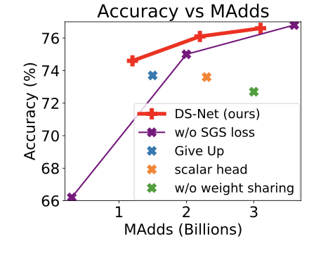
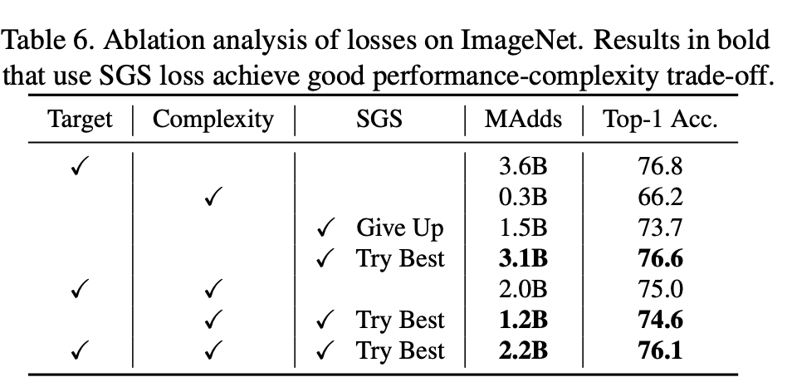
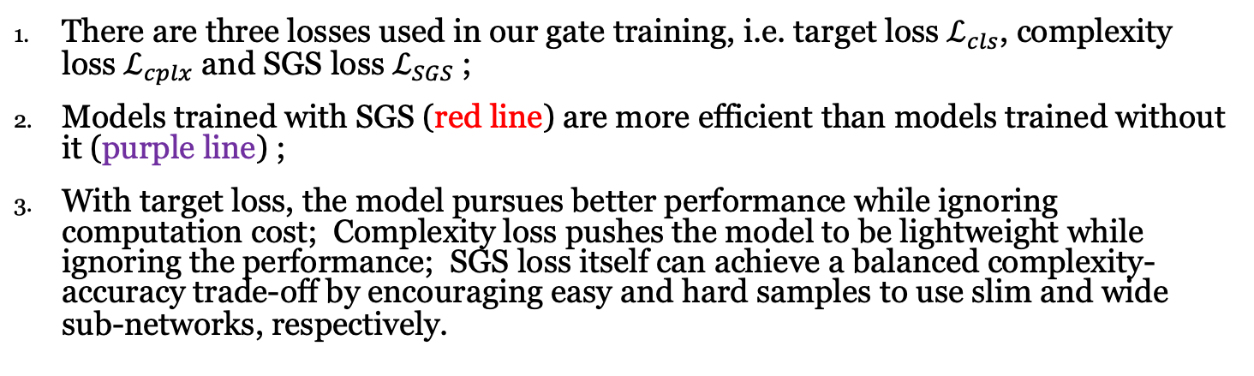
Ablation Study -- Effects of losses
There are three losses used in our gate training, i.e. target loss $ℒ_{cls}$, complexity loss $ℒ_{cplx}$ and SGS loss $ℒ_{SGS}$ ;
Models trained with SGS (red line) are more efficient than models trained without it (purple line) ;
With target loss, the model pursues better performance while ignoring computation cost; Complexity loss pushes the model to be lightweight while ignoring the performance; SGS loss itself can achieve a balanced complexity-accuracy trade-off by encouraging easy and hard samples to use slim and wide sub-networks, respectively.
Notes:
见上图右侧，使用SGS时（红色线），优于不使用SGS的精度（紫色线）；使用双头权重共享门控（红色线），优于不使用权重共享（绿色点）；使用one-hot方式预测（红色线），优于直接预测标量剪枝率（橙色点）

Slide 20
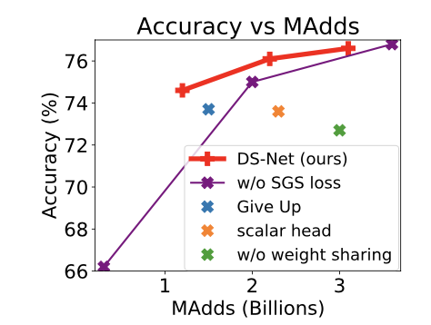
Ablation Study -- SGS Strategy
Try Best: Encourage the hard samples to pass through the widest subnetwork, even if they can not be correctly classified (i.e. T (Xhard) = [0,...,0,1]) ;
Give up: Push the hard samples to use the slimmest path to save computation cost (i.e. T (Xhard) = [1, 0, . . . , 0]).
Give Up strategy lowers the computation complexity of the DS-ResNet but greatly harms the model performance. The models trained with Try Best strategy (red line) outperform the one trained with Give Up strategy (blue dot).
This can be attribute to Give Up strategy’s optimization difficulty and the lack of samples that targeting on the widest path (dependent samples only account for about 10% of the total training samples).
Notes:
Try best 和 give up的定义
损害模型性能。 使用 Try Best 策略（红线）训练的模型优于使用 Give Up 策略（蓝点）训练的模型
这可以归因于 Give Up 策略的优化难度和缺乏针对最宽路径的样本（依赖样本仅占总训练样本的 10% 左右）。

Slide 21
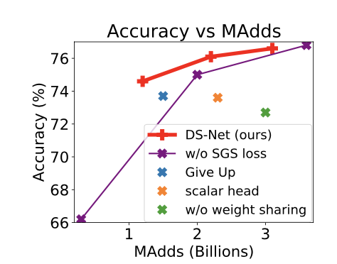
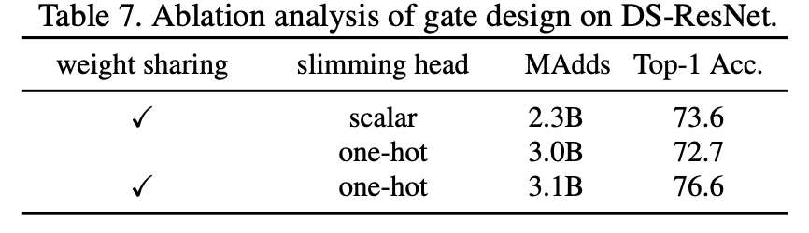
Ablation Study -- SGS Strategy
Effects of sharing the the first fully-connected layer; The performance of DS-ResNet increase substantially (3.9%) by applying the weight sharing design (green dot vs. red line). This might be attribute to overfit- ting of the slimming head.
Whether to use scaler design or one-hot design for the slimming ratio. The performance of scalar design (orange dot) is much lower than the one-hot design (red line), indicating that the scalar gate could not route the input to the correct paths.
Notes:
共享第一个全连接层的效果； 通过应用权重共享设计（绿点与红线），DS-ResNet 的性能显着提高（3.9%）。 这可能是由于瘦头的过度拟合。
瘦身比例是采用定型器设计还是一键式设计。 标量设计（橙色点）的性能远低于单热设计（红线），表明标量门无法将输入路由到正确的路径。

Slide 22
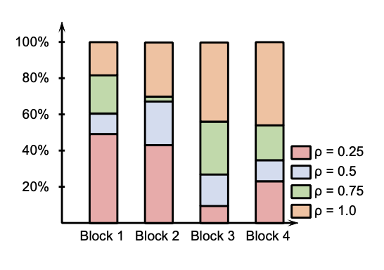
Experiments – Gate Visualization
In block 1 and 2, about half of the inputs are routed to the slimmest sub- network with 0.25 slimming ratio, while in higher level blocks, about half of the inputs are routed to the widest sub-network.
For all the gate, the slimming ratio choices are highly input-dependent, demonstrating the high dynamic diversity of our DS-Net.

Slide 23
Notes:
Dynamic NN,是否是一个方向。组里做prunign的同学也可以结合；
论文写的非常清楚，实验很清晰。

